Slide 1
Chapter 13 Transceiver Design Example
13.1 System-Level Considerations
13.2 Receiver Design
13.3 TX Design
13.4 Synthesizer Design
Behzad Razavi, RF Microelectronics.
Prepared by Bo Wen, UCLA

Slide 2
Chapter Outline
System-Level
Specifications
RX Design
RX NF, IP₃, AGC, and I/Q Mismatch
TX Output Power and P_{1dB}
Synthesizer Phase Noise and Spurs
Frequency Planning
Broadband LNA
Passive Mixer
AGC
Synthesizer Design
TX Design
VCO
Dividers
Charge Pump
PA
Upconverter

Slide 3

Receiver: Noise Figure
11a/g specifies a packet error rate of 10%. Since TX baseband pulse shaping reduces the channel bandwidth to 16.6 MHz, we return to
and obtain
for a sensitivity of -65 dBm (at 52 Mb/s).
In practice, signal detection in the digital baseband processor suffers from nonidealities, incurring a “loss” of a few decibels. Moreover, the front-end antenna switch exhibits a loss of around 1 dB.
Manufacturers typically target an RX noise figure of about 10 dB.

Slide 4
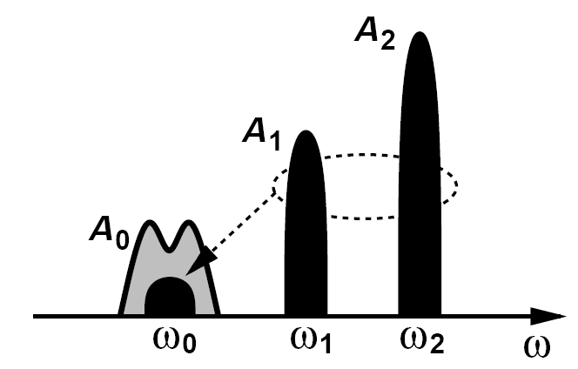
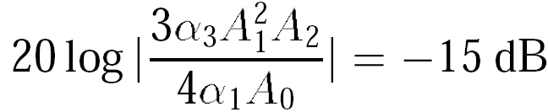
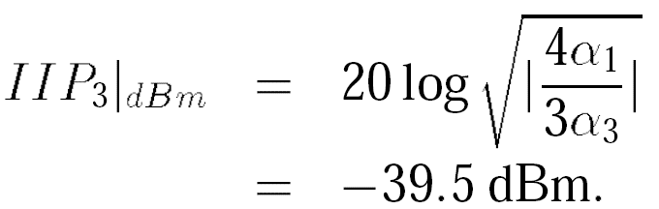
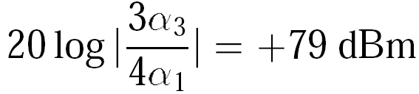
Receiver: Nonlinearity
We represent the desired, adjacent, and alternate channels by A₀ cos ω₀t, A₁ cos ω₁t, and A₂ cos ω₂t, respectively. For a third-order nonlinearity of the form y(t) = α₁x(t) + α₂x2(t) + α₃x3(t), the desired output is given by α₁A₀ cos ω₀t and the IM₃ component at ω₀ by 3α₃A₁2A₂/4
We choose the IM₃ corruption to be around -15 dB to allow for other nonidealities:
The IP₃ corresponding to the 1-dB compression point is satisfied if compression by the desired signal is avoided. The IP₃ arising from adjacent channel specifications must be satisfied while the desired signal is only 3 dB above the reference sensitivity.

Slide 5
Receiver: AGC Range
The receiver must automatically control its gain if the received signal level varies considerably.
The challenge is to realize this gain range while maintaining a noise figure of about 10 dB and an IIP₃ of about -40 dBm.
Determine the AGC range of an 11a/g receiver so as to accommodate the rate-dependent sensitivities.
Solution:
At first glance, we may say that the input signal level varies from -82 dBm to -65 dBm, requiring a gain of 86 dB to 69 dB so as to reach 1 V_{pp} at the ADC input. However, a 64QAM signal exhibits a peak-to-average ratio of about 9 dB; also, baseband pulse shaping to meet the TX mask also creates 1 to 2 dB of additional envelope variation. Thus, an average input level of -65 dBm in fact may occasionally approach a peak of -65 dBm+11 dB = -54 dBm. It is desirable that the ADC digitize this peak without clipping. That is, for a -65-dBm 64QAM input, the RX gain must be around 58 dB. The -82-dBm BPSK signal, on the other hand, displays only 1 to 2 dB of the envelope variation, demanding an RX gain of about 84 dB.

Slide 6
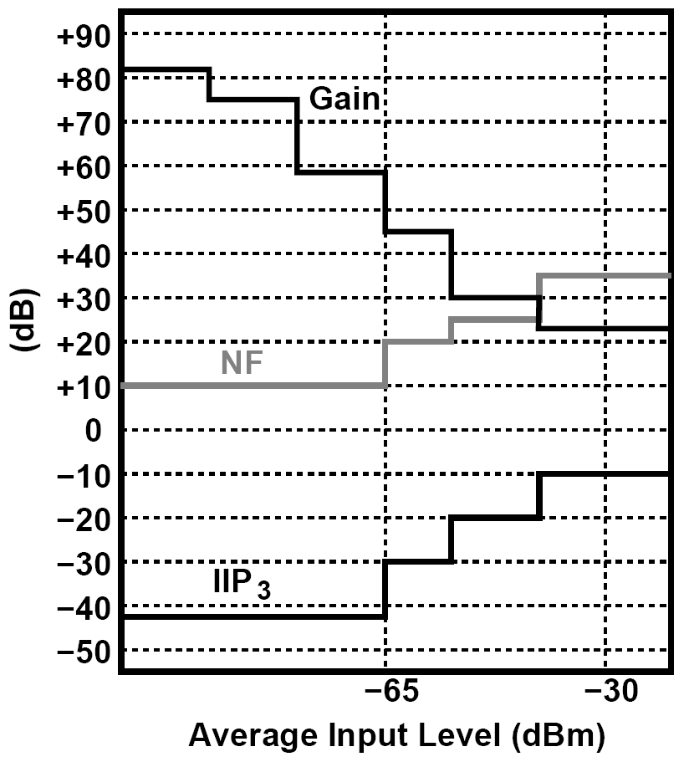
ACG Range: Required RX Gain Switching and NF and IIP₃ Variations
The receiver gain range is also determined by the maximum allowable desired input level (-30dBm). The baseband ADC preferably avoids clipping the peaks of the waveforms.
The actual number of steps chosen here depends on the design of the RX building blocks and may need to be quite larger than that depicted

Slide 7
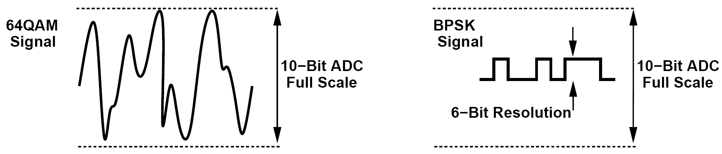
Example of AGC Range: Choice of Gain
The choice of the gain in the above example guarantees that the signal level reaches the ADC full scale for 64QAM as well as BPSK modulation. Is that necessary?
Solution:
No, it is not. The ADC resolution is selected according to the SNR required for 64QAM modulation (and some other factors). For example, a 10-bit ADC exhibits an SNR of about 62 dB, but a BPSK signal can tolerate a much lower SNR and hence need not reach the ADC full scale. In other words, if the BPSK input is amplified by, say, 60 dB rather than 84 dB, then it is digitized with 6 bits of resolution and hence with ample SNR (≈ 38 dB) . In other words, the above AGC calculations are quite conservative.

Slide 8
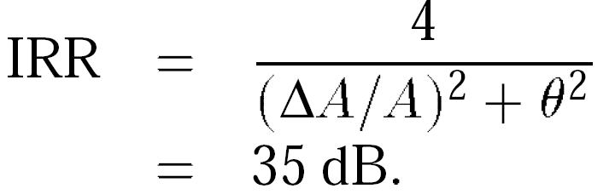
Receiver: I/Q Mismatch
The I/Q mismatch study proceeds as follows.
(1) To determine the tolerable mismatch, we must apply in system simulations a 64QAM OFDM signal to a direct-conversion receiver and measure the BER or the EVM. Such simulations are repeated for various combinations of amplitude and phase mismatches, yielding the acceptable performance envelope.
(2) Using circuit simulations and random device mismatch data, we must compute the expected I/Q mismatches in the quadrature LO path and the downconversion mixers.
(3) Based on the results of the first two steps, we must decide whether the “raw” matching is adequate or calibration is necessary.
A hypothetical image-reject receiver exhibits the above I/Q mismatch values. Determine the image rejection ratio.
The gain mismatch, 2(A₁ - A₂)/(A₁ + A₂) ≈ (A₁ - A₂)/A₁ = ΔA/A, is obtained by raising 10 to the
power of (0.2 dB/20) and subtracting 1 from the result. Thus,

Slide 9
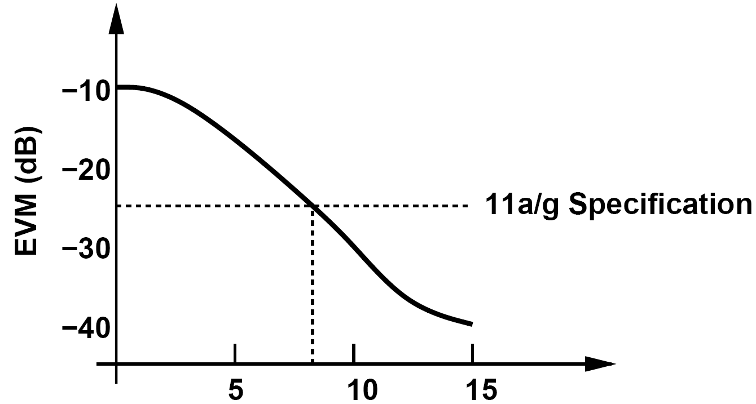
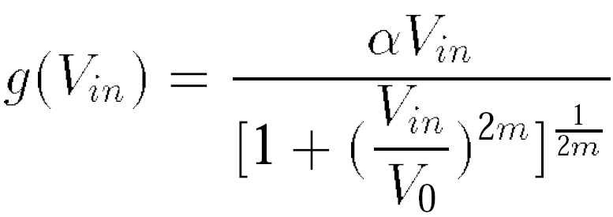
Transmitter
The transmitter chain must be linear enough to deliver a 64QAM OFDM signal to the antenna with acceptable distortion.
High linearity:
assign most of gain to last PA stage
(2)minimize the number of stages in the TX chain
An 11a/g TX employs a two-stage PA having a gain of 15 dB. Can a quadrature upconverter directly drive this PA?
The output P_{1dB} of the upconverter must exceed +24 dBm - 15 dB = +9 dBm = 1.78 V_{pp}. It is difficult to achieve such a high P_{1dB} at the output of typical mixers. A more practical approach therefore attempts to raise the PA gain or interposes another gain stage between the upconverter and the PA.

Slide 10
Frequency Synthesizer: Example of Reciprocal Mixing (Ⅰ)
For the dual-band transceiver developed in this chapter, the synthesizer must cover the 2.4-GHz and 5-GHz bands with a channel spacing of 20 MHz. In addition, the synthesizer must achieve acceptable phase noise and spur levels.
Determine the required synthesizer phase noise for an 11a receiver such that reciprocal mixing is negligible.
Solution:
We consider the high-sensitivity case, with the desired input at -82 dBm + 3 dB and the adjacent and alternate channels at +16 dB and +32 dB, respectively. Figure below shows the corresponding spectrum but with the adjacent channels modeled as narrow-band blockers to simplify the analysis. Upon mixing with the LO, the three components emerge in the baseband, with the phase noise skirts of the adjacent channels corrupting the desired signal. Since the synthesizer loop bandwidth is likely to be much smaller than 20 MHz, we can approximate the phase noise skirts by S_{Φ}(f) = α/f2. Our objective is to determine α.

Slide 11
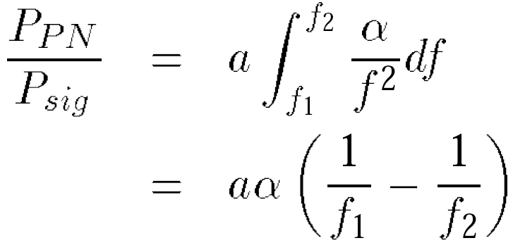
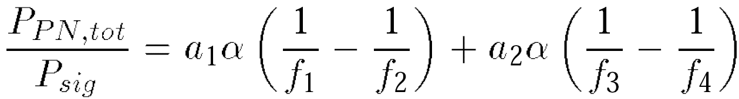
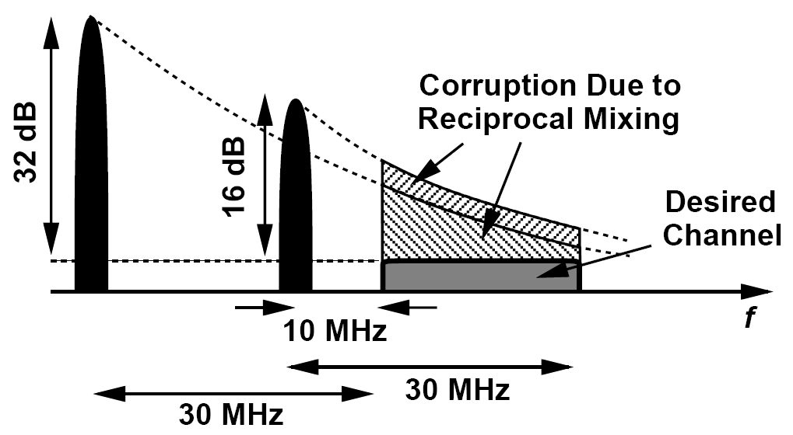
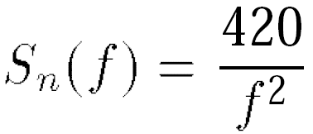
Frequency Synthesizer: Example of Reciprocal Mixing(Ⅱ)
If a blocker has a power that is a times the desired signal power, P_{sig} , then the phase noise power, P_{PN}, between frequency offsets of f₁ and f₂ and normalized to P_{sig} is given by
In the scenario of figure below, the total noise-to-signal ratio is equal to
where a₁ = 39.8 (= 16 dB), f₁ = 10 MHz, f₂ = 30 MHz, a₂ = 1585 (= 32 dB), f₃ = 30 MHz, f₄ = 50 MHz. We wish to ensure that reciprocal mixing negligibly corrupts the signal:

Slide 12
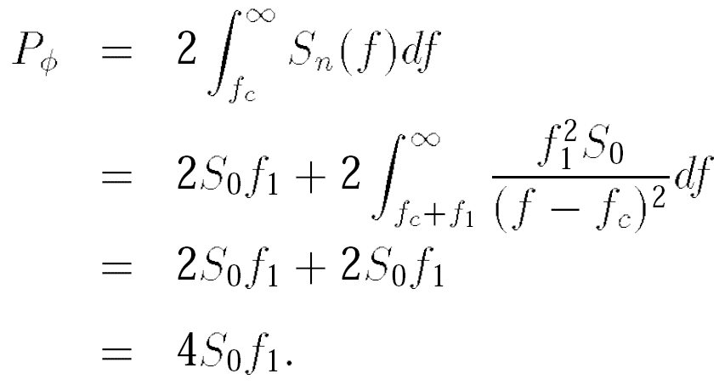
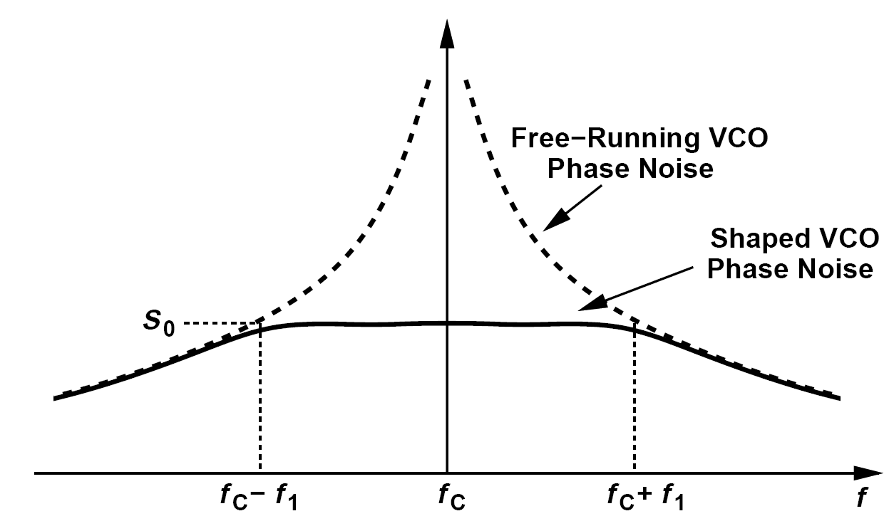
Frequency Synthesizer Phase Noise
In the absence of reciprocal mixing, the synthesizer phase noise still corrupts the signal constellation. For this effect to be negligible in 11a/g, the total integrated phase noise must remain less than 1 °
Denoting the value of α/(f - f_{c})2 at f = f_{c} ± f₁ by S₀, we have α = S₀f₁2 and:

Slide 13
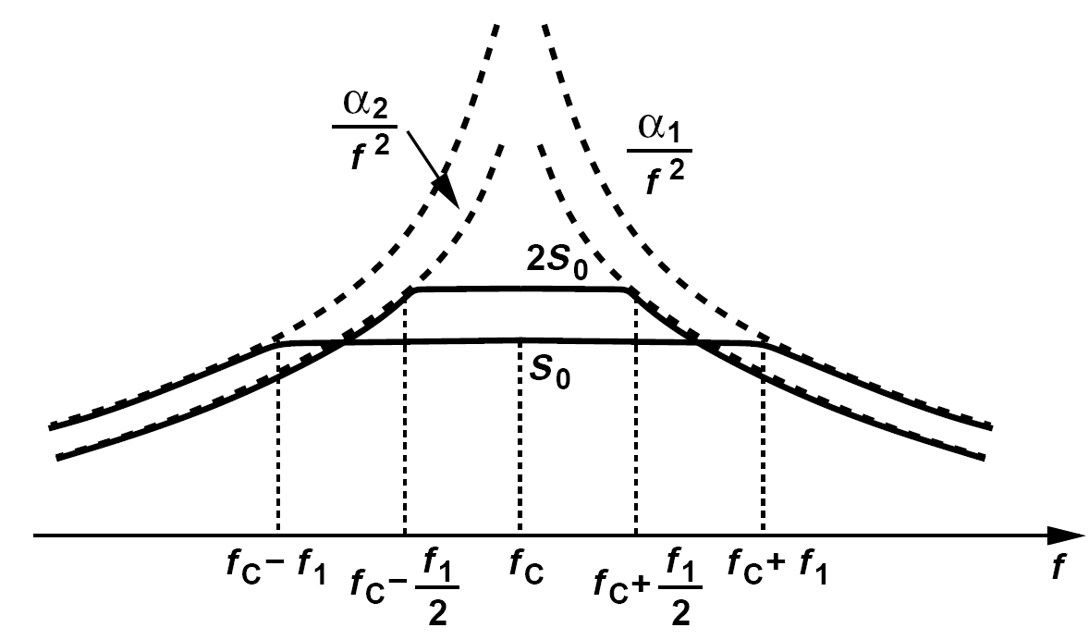
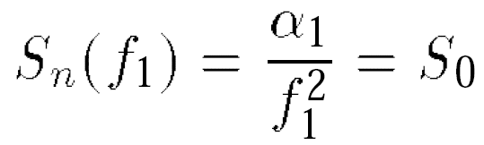
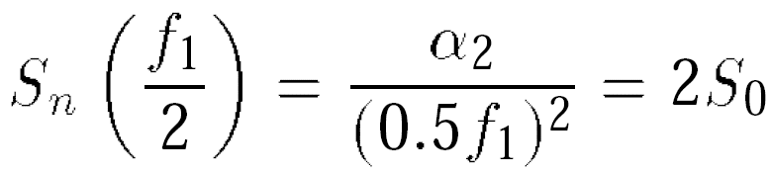
Effect of reducing PLL bandwidth on phase noise
A student reasons that a greater free-running phase noise, S₀, can be tolerated if the synthesizer loop bandwidth is reduced. Thus, f₁ must be minimized. Explain the flaw in this argument.
Consider two scenarios with VCO phase noise profiles given by α₁/f2 and α₂/f2. Suppose the loop bandwidth is reduced from f₁ to f₁/2 and S₀ is allowed to rise to 2S₀ so as to maintain P_{ϕ} constant.
In the former case,
And hence α₁=f₁2S₀. In the latter case,
and hence α₂ = 0.5f₁2S₀. It follows that the latter case demands a lower free-running phase noise at an offset of f₁, making the VCO design more difficult.

Slide 14
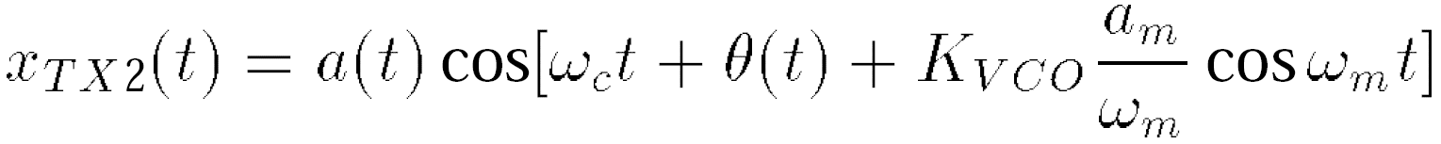
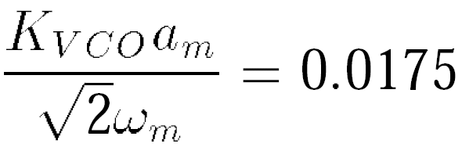
Synthesizer Output Spurs
For an input level of -82 dBm+3 dB = -79 dBm, spurs in the middle of the adjacent and alternate channels downconvert blockers that are 16 dB and 32 dB higher, respectively.
The spurs also impact the transmitted signal. To estimate the tolerable spur level, we return to the 1° phase error mentioned above (for random phase noise) and force the same requirement upon the effect of the (FM) spurs.
only with phase noise, ϕ_{n}(t)
and only with a small FM spur:
For the total rms phase deviation to be less than 1 ° = 0:0175 rad, we have
The relative sideband level in x_{TX2}(t) is equal to K_{VCO}a_{m}/(2ω_{m}) = 0:0124 = -38 dBc.

Slide 15
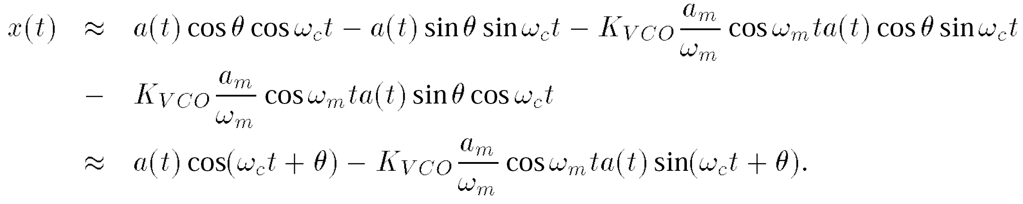
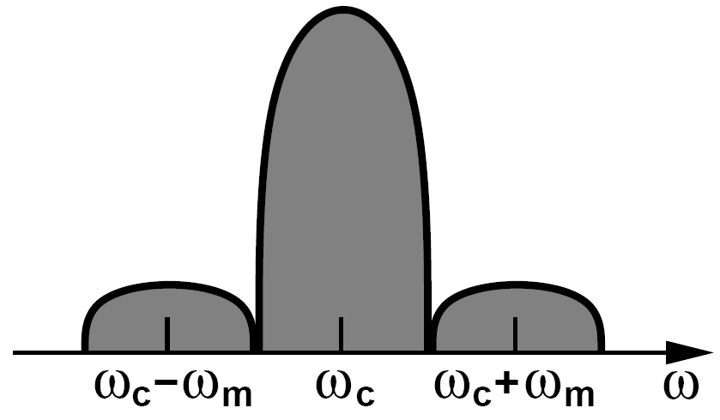
Example of Spurs
A quadrature upconverter designed to generate a(t) cos[ω_{c}t + θ(t)] is driven by an LO having FM spurs. Determine the output spectrum.
Representing the quadrature LO phases by cos[ω_{c}t + (K_{VCO}a_{m}/ω_{m}) cos ω_{m}t ] and sin[ω_{c}t +
(K_{VCO}a_{m}/ω_{m}) cosω_{m}t ], we write the upconverter output as
We assume K_{VCO}a_{m}/ω_{m} << 1 rad and expand the terms:
The output thus contains the desirable component and the quadrature of the desirable component shifted to center frequencies of ω_{c} - ω_{m} and ω_{c} + ω_{m}. The key point here is that the synthesizer spurs are modulated as they emerge in the TX path.

Slide 16
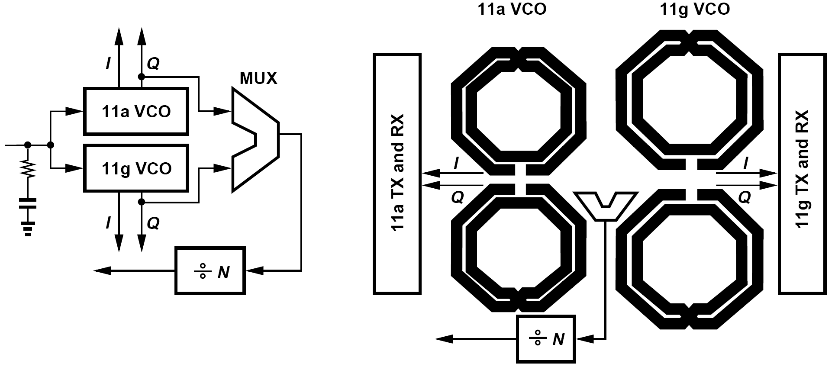
Frequency Planning (Ⅰ)
Two separate quadrature VCOs for the to bands, with their outputs multiplexed and applied to the feedback divider chain.
Floor plan imposes a large spacing between the 11a and 11g signal paths.
11a VCO must provide a tuning range of ±15%. LO pulling proves serious.

Slide 17
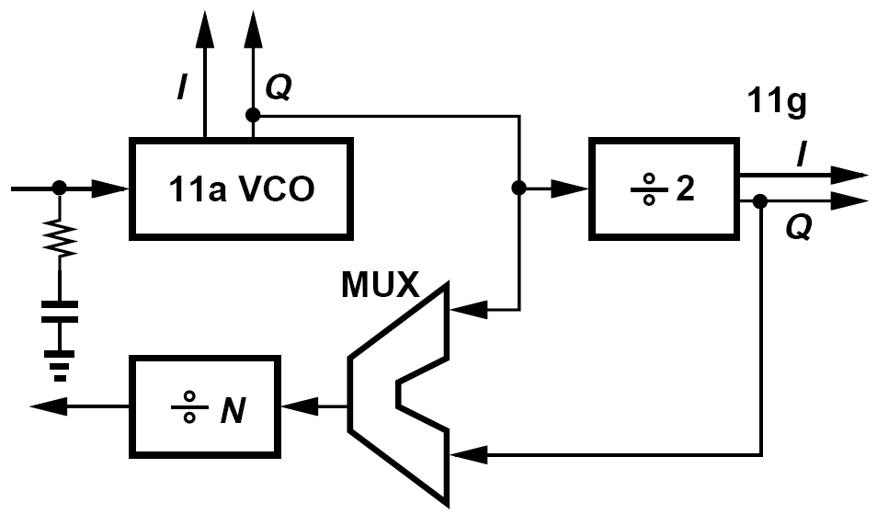
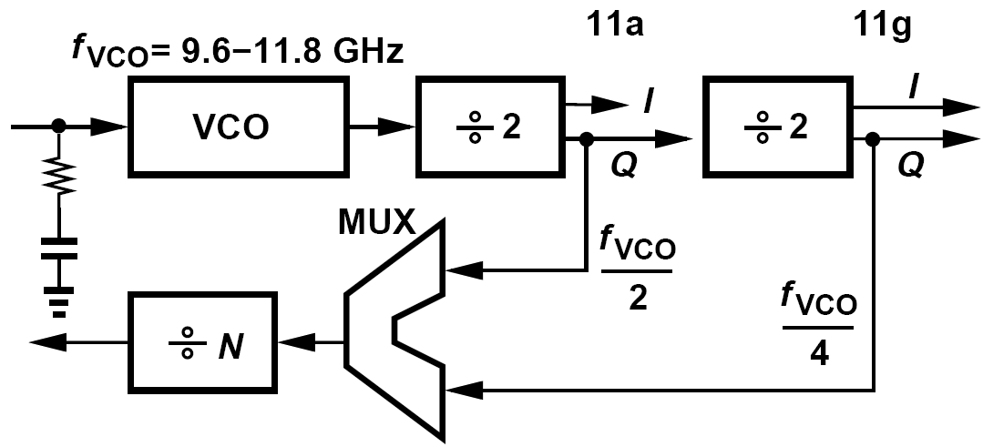
Frequency Planning (Ⅱ)
One quadrature VCO serving both bands.
More compact floor plan.
LO pulling persists. It is desirable to implement the 11g PA in fully-differential form.
One differential VCO operating from 2 × 4.8 GHz to 2 × 5.9 GHz
Compact floor plan.
A tuning range of ±21%
Differential 11a and 11g PAs
A ÷2 circuit that robustly operates up to 12GHz, preferably with no inductors.

Slide 18
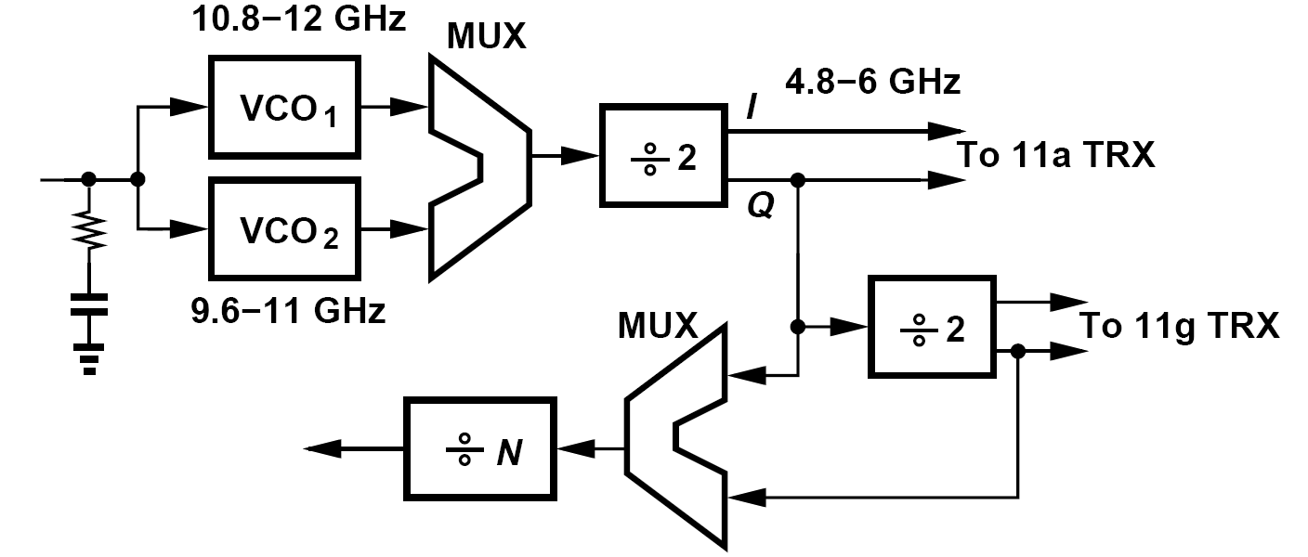
Frequency Planning (Ⅲ)
We employ two VCOs, each with about half the tuning range but with some overlap to avoid a blind zone.
A larger number of VCOs can be utilized to allow an even narrower tuning range for each, but the necessary additional inductors complicate the routing.

Slide 19
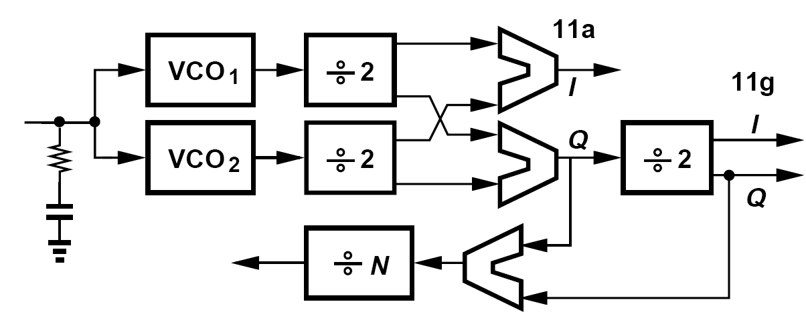
Examples of Floor Planning
Explain why the outputs of the two ÷ 2 circuits in the previous architecture with a VCO and a divider for the two bands are multiplexed. That is, why not apply the f_{VCO}=4 output to the ÷ N stage in the 11a mode as well?
Driving the ÷ N stage by f_{VCO}=4 is indeed desirable as it eases the design of this circuit. However, in an integer-N architecture, this choice calls for a reference frequency of 10MHz rather than 20MHz in the 11a mode, leading to a smaller loop bandwidth and less suppression of the VCO phase noise.
The MUX following the two VCOs in the above architecture with two VCOs must either consume a high power or employ inductors. Is it possible to follow each VCO by a ÷2 circuit and perform the multiplexing at the dividers’ outputs?
The two multiplexers do introduce additional I/Q mismatch, but calibration removes this
error along with other blocks’ contributions. Note that the new ÷2 circuit does not raise the power consumption because it is turned off along with VCO₂ when not needed.

Slide 20
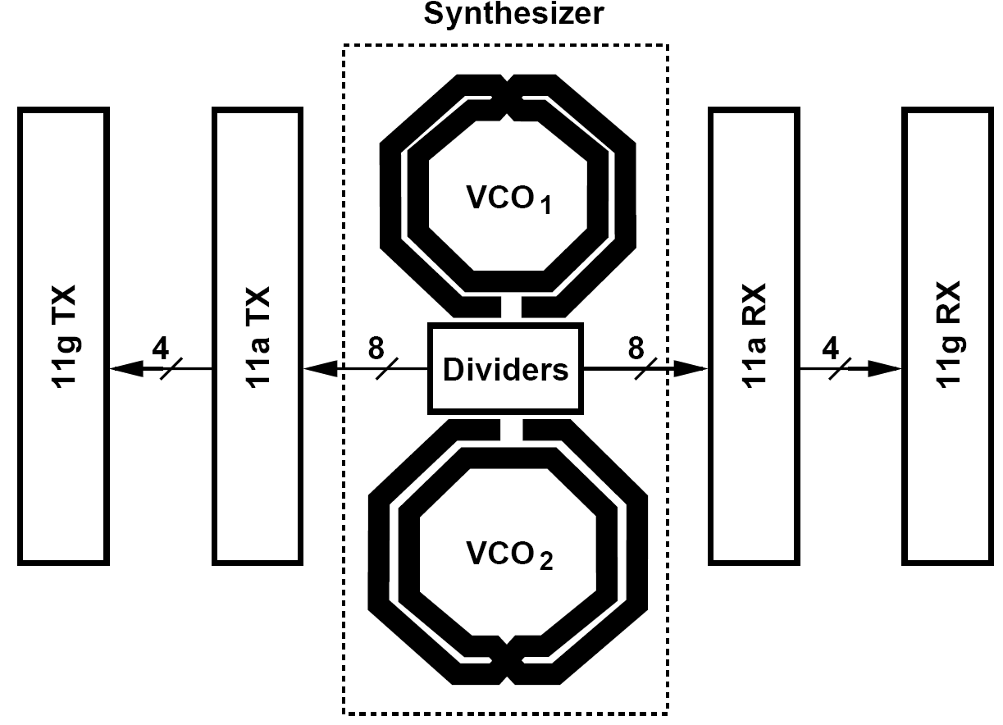
How Synthesizer is Shared Between the TX and RX Path?
The synthesizer outputs directly drive both paths.
In practice, buffers may be necessary before and after the long wires.

Slide 21
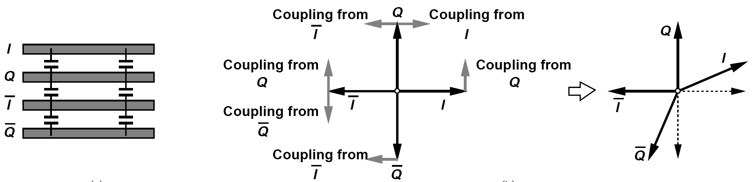
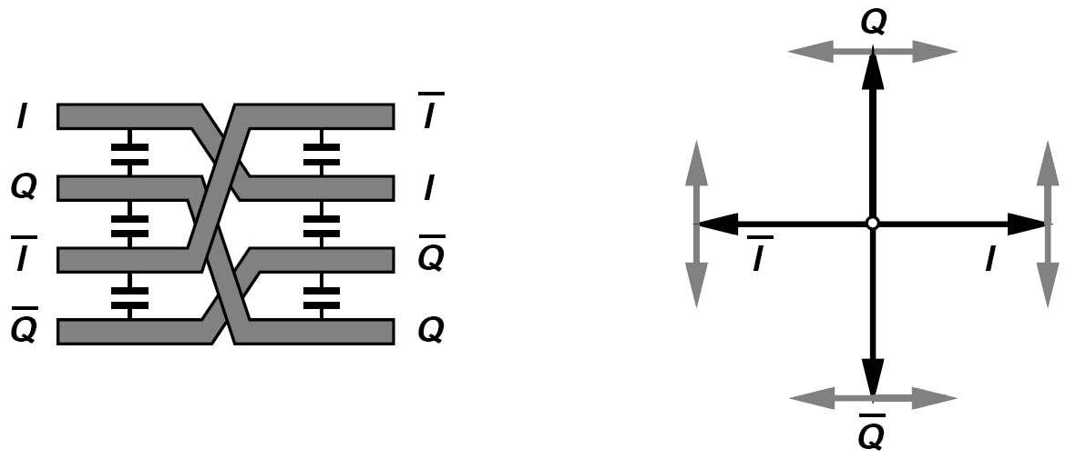
Example of I/Q Mismatches after Long Interconnects
Differential I and Q signals experience deterministic mismatches as they travel on long interconnects. Explain why and devise a method of suppressing this effect.
Consider the arrangement shown in (a). Owing to the finite resistance and coupling capacitance of the wires, each line experiences an additive fraction of the signal(s) on its immediate neighbor(s) (b). Thus, I and Q depart from their ideal orientations. To suppress this effect, we rearrange the wires as shown in (c) at half of the distance between the end points, creating a different set of couplings. Illustrated in (d) are all of the couplings among the wires, revealing complete cancellation.
(a) (b)
(c) (d)

Slide 22
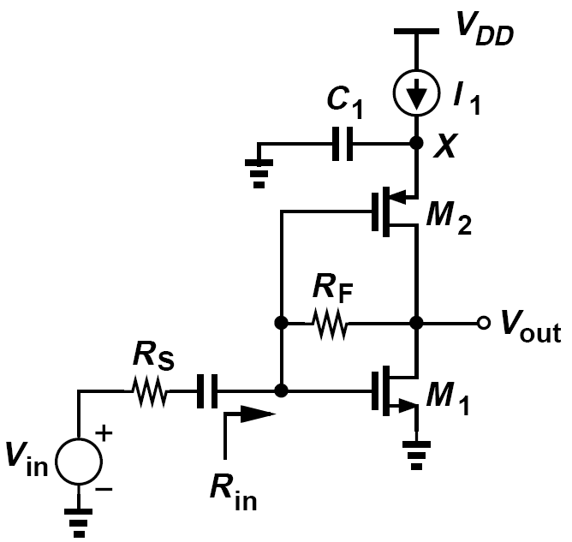
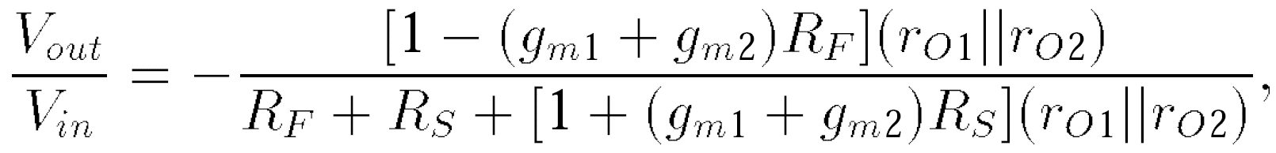
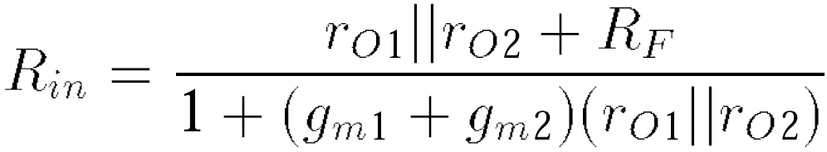
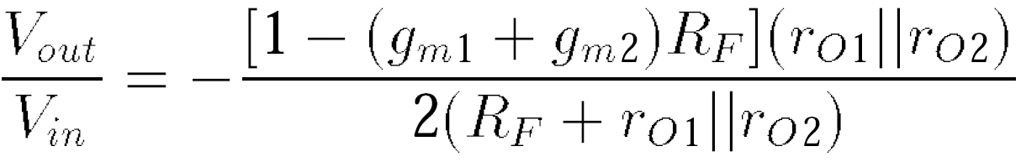
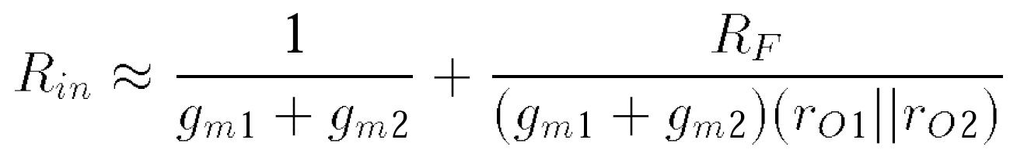
Receiver Design: LNA Design (Ⅰ)
Is it possible to employ only one LNA for the two bands?
Equating R_{in} to R_{S} and making a substitution
in the denominator, we have
Suppose (g_{m1} + g_{m2})(r_{O1}||r_{O2}) >> 1.
First term should be on the order of 10 to 20 Ω, and the second, 30 to 40 Ω. And we can compute the gain equals -2.8.

Slide 23
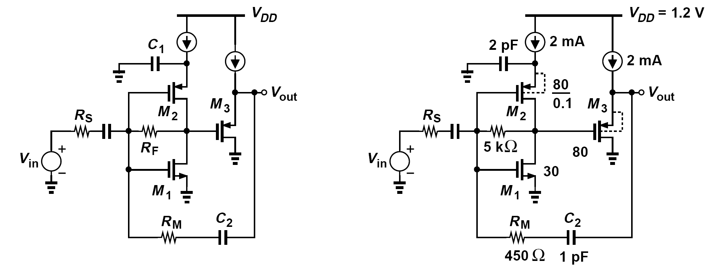
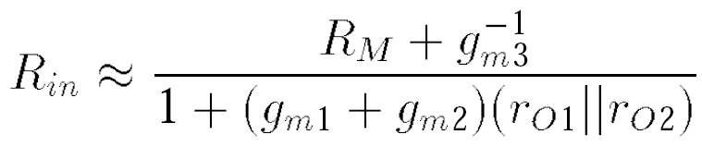
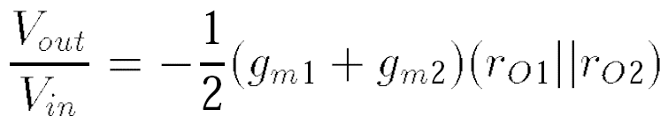
Receiver Design: LNA Design (Ⅱ)
Modified to have a higher gain:
the input resistance is given by the feedback resistance divided by one plus the loop gain:
If R_{in} = R_{S} and R_{M} >> g_{m3}-1, then the gain is simply equal to 1/2 times the voltage gain of the inverter:

Slide 24
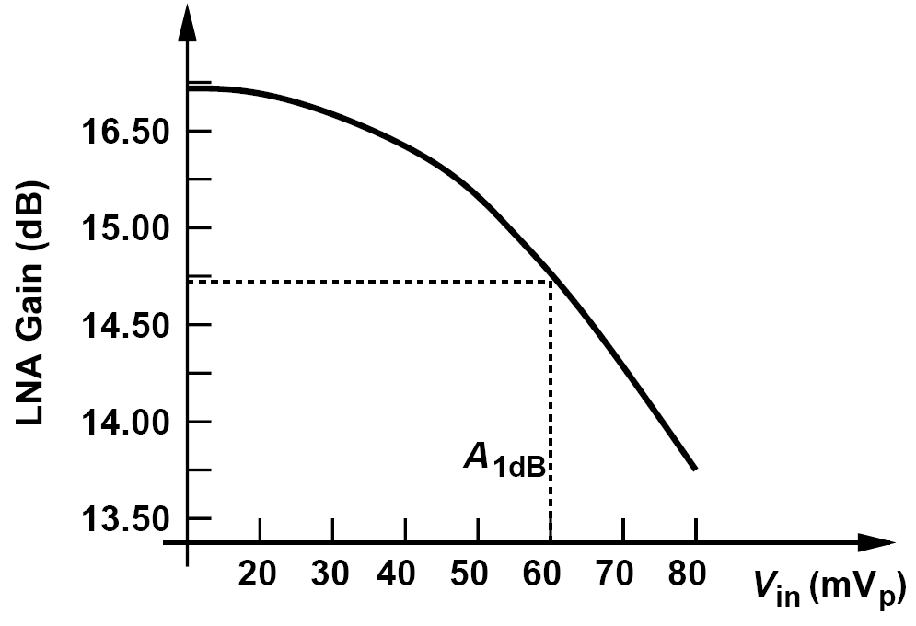
Example of Input Capacitance of LNA
The large input transistors in the previous figure present an input capacitance, C_{in}, of about 200 fF (including the Miller effect of C_{GD1} + C_{GD2}). Does this capacitance not degrade the input match at 6 GHz?
Since (C_{in}ω)-1 ≈ 130 Ω is comparable with 50 Ω, we expect C_{in} to affect S₁₁ considerably. Fortunately, however, the capacitance at the output node of the inverter creates a pole that drops the open-loop gain at high frequencies, thus raising the closed-loop input impedance.
Shown here is the LNA gain as a function of the input level at 6 GHz. By virtue of the feedback, the LNA achieves a P_{1dB} of about -14 dBm.

Slide 25
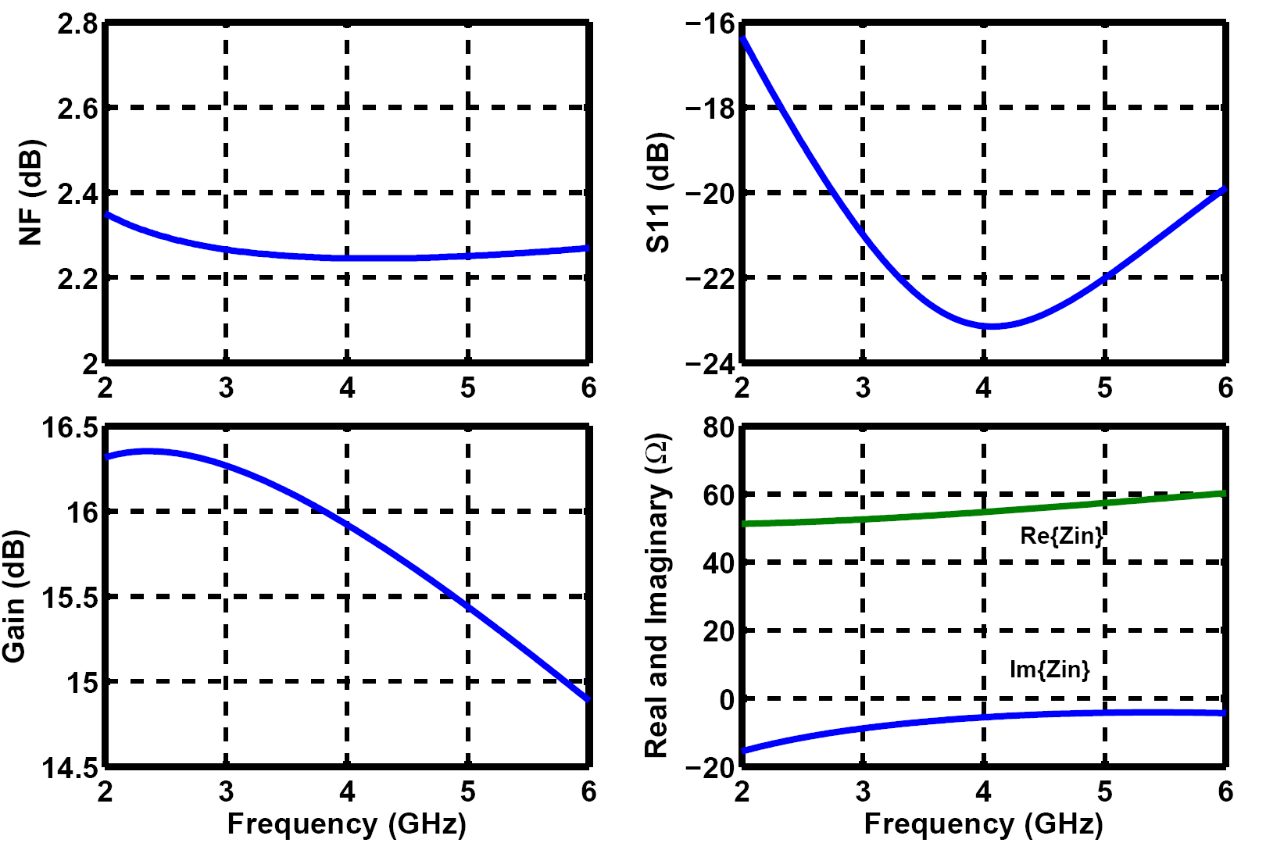
Simulated Characteristics of 11a/g LNA
The worst-case |S₁₁|, NF, and gain are equal to -16.5 dB, 2.35 dB, and 14.9 dB, respectively.

Slide 26
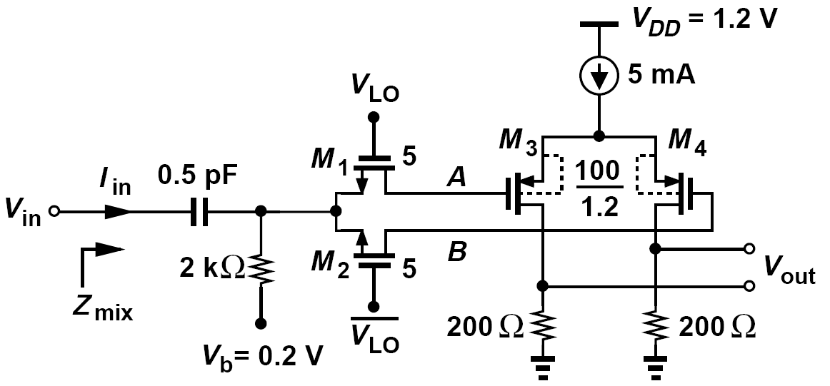
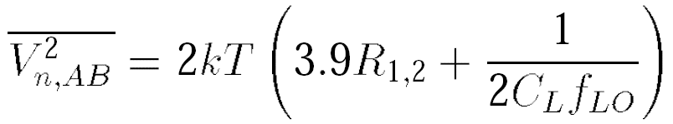
Mixer Design
In this transceiver design, we have some flexibility because (a) 65-nm CMOS technology can provide rail-to-rail LO swings at 6 GHz, allowing passive mixers, and (b) the RX linearity is relatively relaxed, allowing active mixers.
Transistors M₃ and M₄ present a load capacitance of C_{L} ≈ (2/3)WLC_{ox} ≈ 130 fF to the mixer devices. The differential noise measured between A and B is thus given by

Slide 27
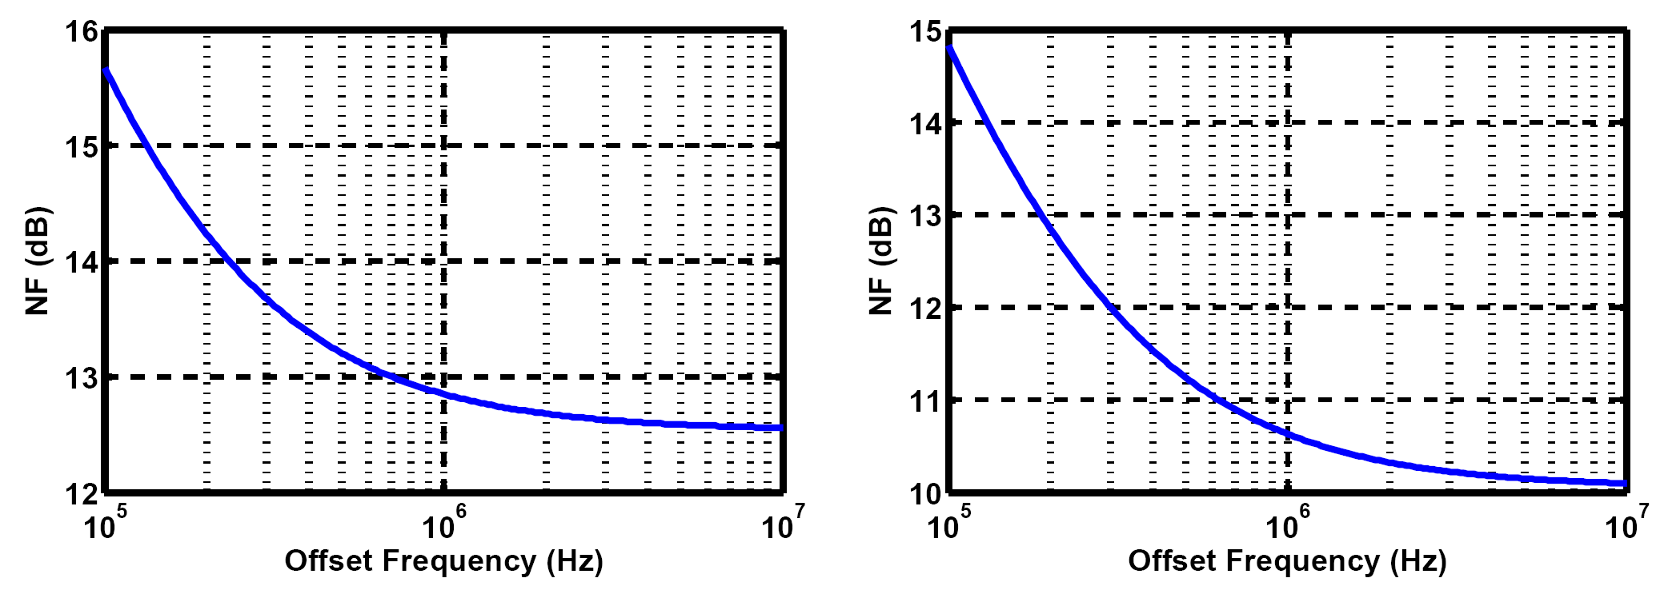
Simulated NF of the Mixer
Figure below plots the simulated double-sideband noise figure of the mixer of figure above with respect to a 50-Ω source impedance
For a 6-GHz LO, the NF is dominated by the flicker noise of the baseband amplifier at 100-kHz offset. For a 2.4-GHz LO, the thermal noise floor rises by 3 dB. The simulations assume a rail-to-rail sinusoidal LO waveform.

Slide 28
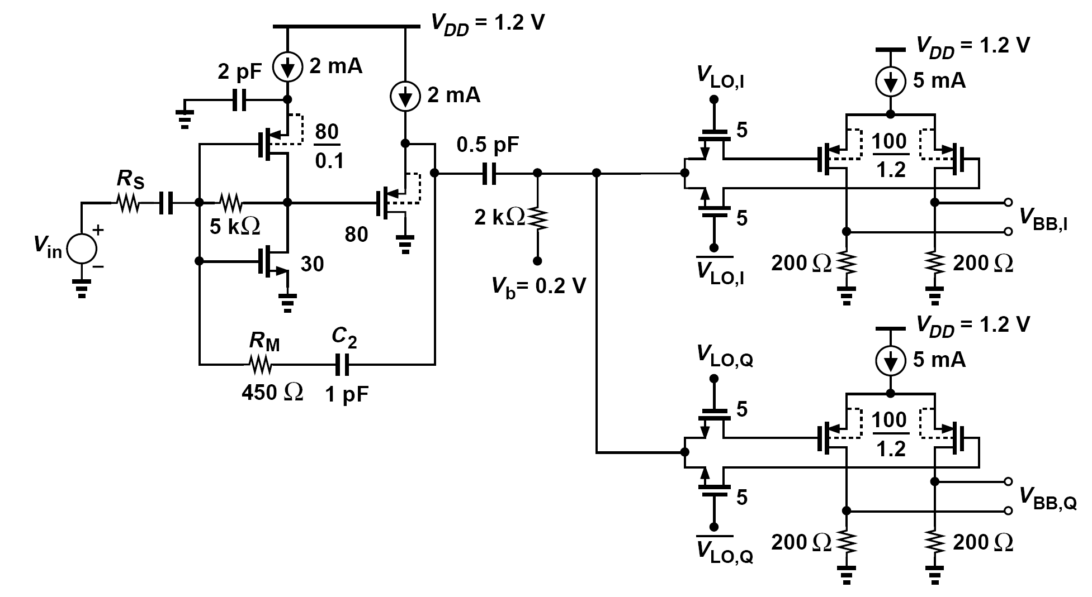
Overall 11a/g Receiver Design
We finally arrive at the overall receiver design shown below:

Slide 29
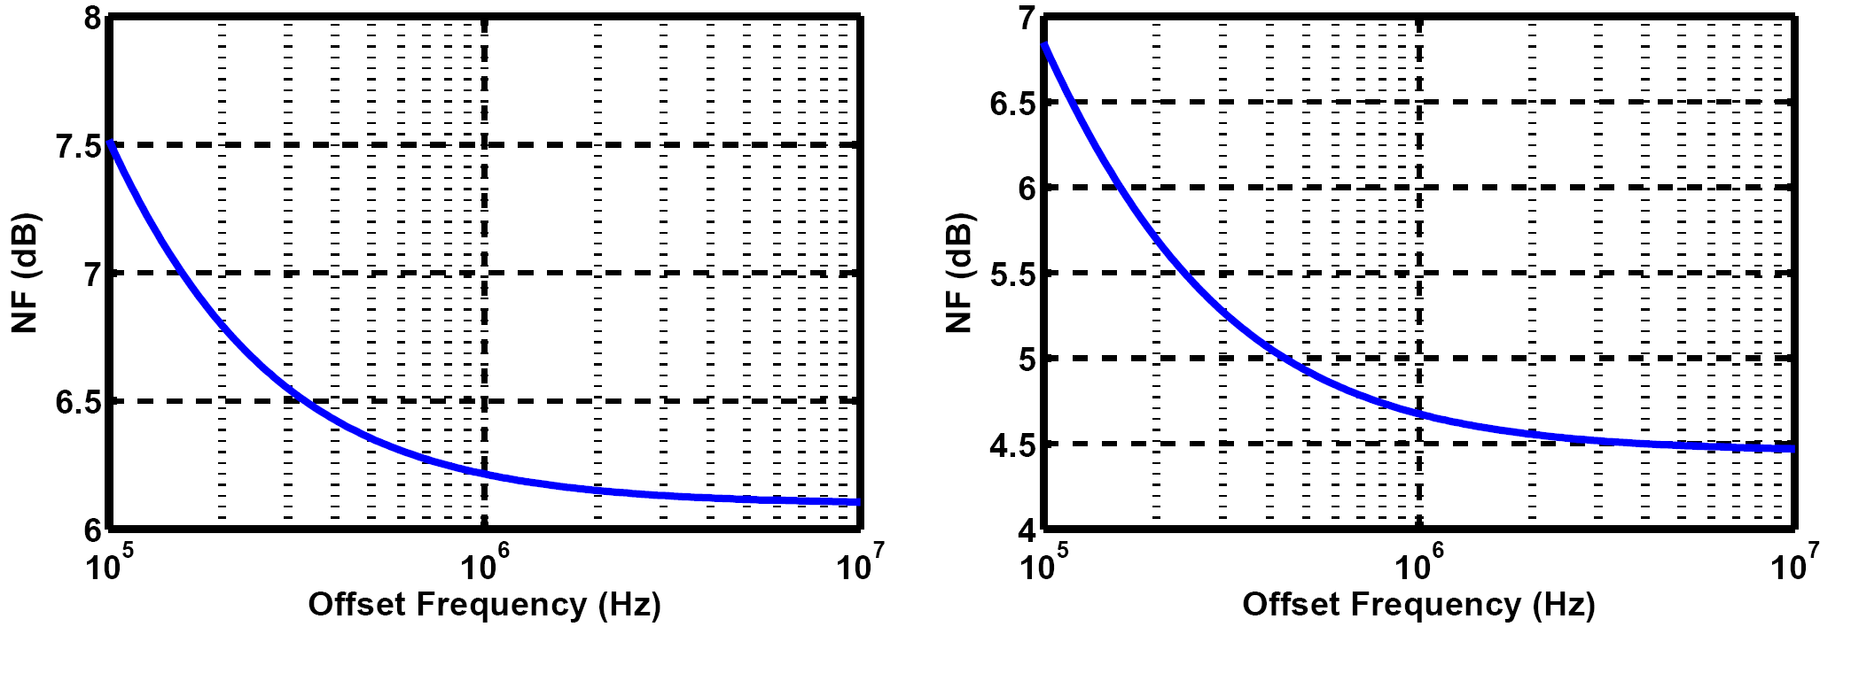
Simulated NF of the Overall Receiver
The RX noise figure varies from 7.5 dB to 6.1 dB at 2.4 GHz and from 7 dB to 4.5 dB at 6 GHz. These values are well within our target of 10 dB.

Slide 30
Examples of Issues in Mixer Design
How is the receiver sensitivity calculated if the noise figure varies with the frequency?
A simple method is to translate the NF plot to an output noise spectral density plot and compute the total output noise power in the channel bandwidth (10 MHz). In such an approach, the flicker noise depicted in above simulation contributes only slightly because most of its energy is carried between 100 kHz and 1 MHz. In an OFDM system, on the other hand, the flicker noise corrupts some subchannels to a much greater extent than other subchannels. Thus, system simulations with the actual noise spectrum may be necessary.
The input impedance, Z_{mix}, in previous mixer may alter the feedback LNA input return loss. How is this effect quantified?
The LNA S₁₁ is obtained using small-signal ac simulations. On the other hand, the input impedance of passive mixers must be determined with the transistors switching, i.e., using transient simulations. To study the LNA input impedance while the mixers are switched, the FFT of I_{in} can be taken and its magnitude and phase plotted. With the amplitude and phase of V_{in} known, the input impedance can be calculated at the frequency of interest.

Slide 31
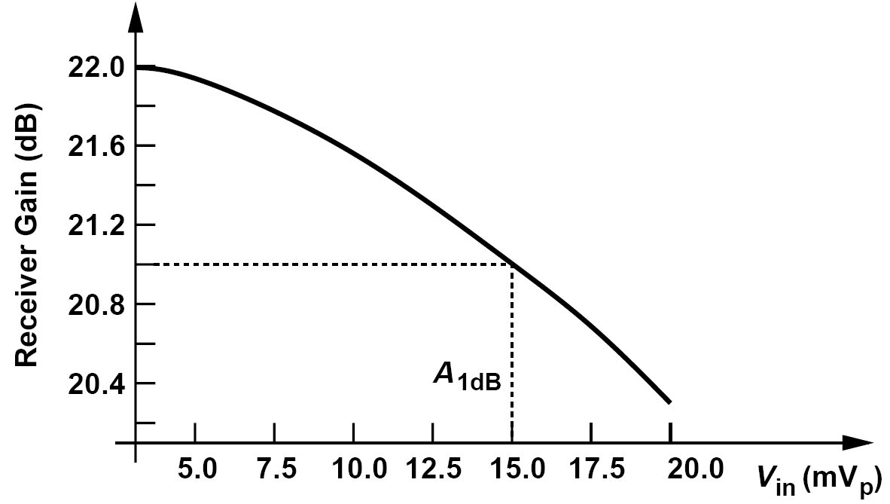
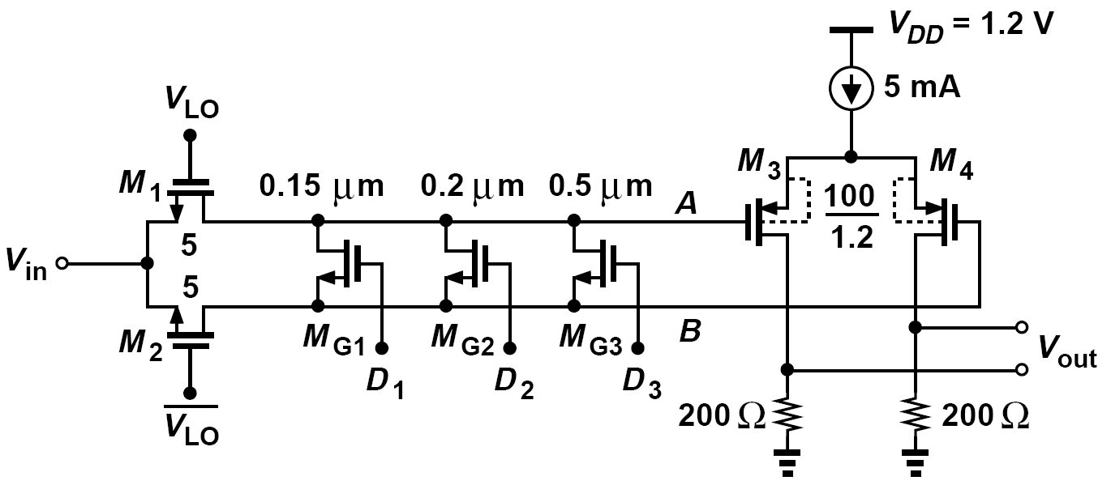
Coarse AGC
Dominated by the baseband differential pair, the RX P_{1dB} is quite lower than that of the LNA. It is therefore desirable to lower the mixer gain as the average RX input level approaches -30 dBm
This is accomplished by inserting transistors M_{G1}- M_{G3} between the differential outputs of the mixer.

Slide 32
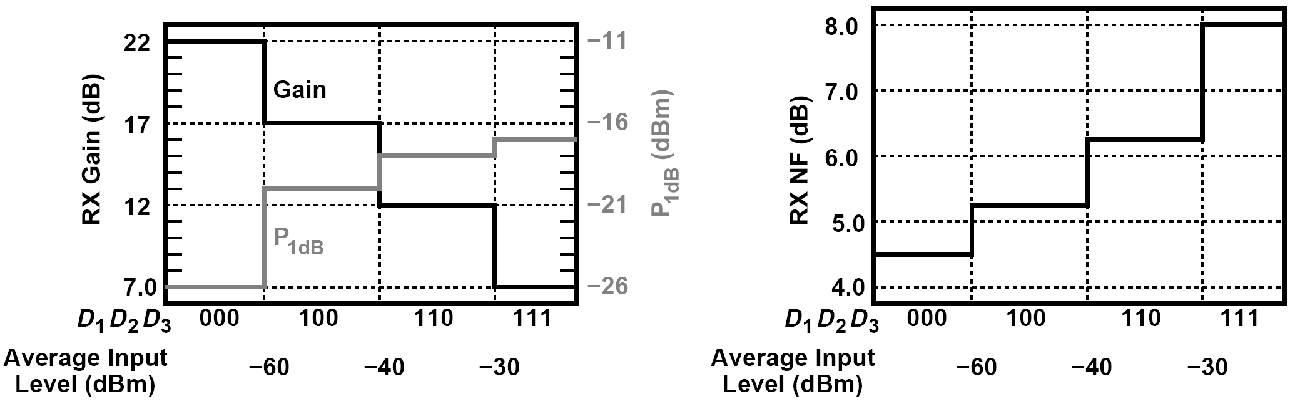
Coarse AGC: Gain Settings
Owing to their small dimensions, M_{G1}-M_{G3} suffer from large threshold variations. It is therefore preferable to increase both the width and length of each device by a factor of 2 to 5 while maintaining the desired on-resistance.
The characteristics above indicate that the RX P_{1dB} hardly exceeds -18 dBm even as the gain is lowered further.

Slide 33
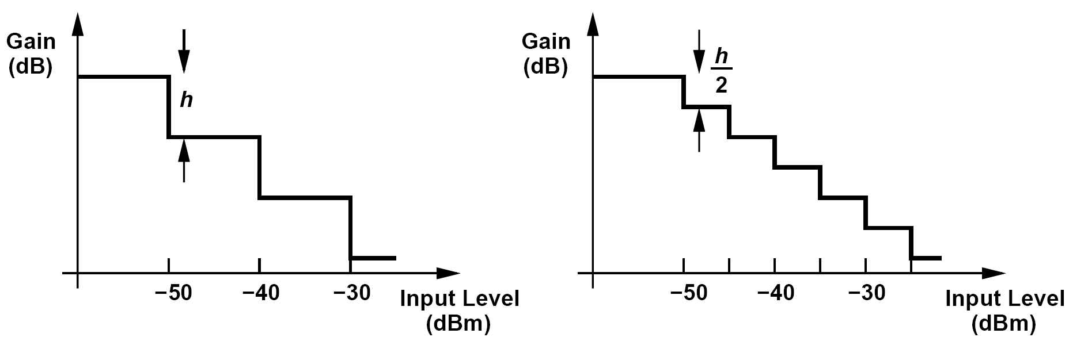
Examples of AGC
What controls D₁-D₃?
The digital control for D₁-D₃ is typically generated by the baseband processor. Measuring the signal level digitized by the baseband ADC, the processor determines how much attenuation is necessary.
What gain steps are required for the fine AGC?
The fine gain step size trades with the baseband ADC resolution. To understand this point, consider the example shown in figure below, where the gain changes by h dB for every 10-dB change in the input level. Thus, as the input level goes from, say, -39.9 dBm to -30.1 dBm, the gain is constant and hence the ADC input rises by 10 dB. The ADC must therefore (a) digitize the signal with proper resolution when the input is around -39.9 dBm, and (b) accommodate the signal without clipping when the input is around -30.1 dBm.
Now consider the gain switching occurs for every 5-dB change in the input level. In this case, the ADC must provide 5 dB of additional resolution (dynamic range).

Slide 34
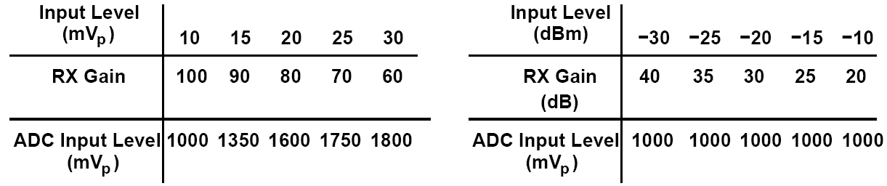

Example of AGC’s “Linear-in-dB” Gain
In AGC design, we seek a programmable gain that is “linear in dB,” i.e., for each LSB increase in the digital control, the gain changes by h dB and h is constant. Explain why.
The baseband ADC and digital processor measure the signal amplitude and adjust the digital gain control. Let us consider two scenarios for the gain adjustment as a function of the signal level. As shown below, in the first scenario the (numerical) gain is reduced by a constant (numerical) amount (10) for a constant increase in the input amplitude (5 mV). In this case, the voltage swing sensed by the ADC (= input level × RX gain) is not constant, requiring nearly doubling the ADC dynamic range as the input varies from 10 mV_{p} to 30 mV_{p}.
In the second scenario, the RX gain is reduced by a constant amount in dB for a constant logarithmic increase in the signal level, thereby keeping the ADC input swing constant. Here, for every 5 dB rise in the RX input, the baseband processor changes the digital control by 1 LSB, lowering the gain by 5 dB. It is therefore necessary to realize a linear-in-dB gain control mechanism.

Slide 35

Fine AGC
The gain is reduced by raising the degeneration resistance.
In the circuit above (left), the nonlinearity of M_{G1}-M_{Gn} may manifest itself for large input swings.

Slide 36

Simulated RX Performance with VGA
We observe that (a) the RX P_{1dB} drops from -26 dBm to -31 dBm when the VGA is added to the chain, and (b) the noise figure rises by 0.2 dB in the low-gain mode. The VGA design thus favors the NF at the cost of P_{1dB}—while providing a maximum gain of 8 dB.
A student seeking a higher P_{1dB} notes that the NF penalty for D₁D₂D₃D₄ = 0011 is negligible and decides to call this setting the “high-gain” mode. That is, the student simply omits the higher gain settings for 0000 and 0001. Explain the issue here.
In the “high-gain” mode, the VGA provides a gain of only 4 dB. Consequently, the noise of the next stage (e.g., the baseband filter) may become significant.

Slide 37

TX Design: PA Design
The PA must deliver +16 dBm (40 mW) with an output P_{1dB} of +24 dBm. The corresponding peak-to-peak voltage swings across a 50-Ω antenna are 4 V and 10 V, respectively. We assume an off-chip 1-to-2 balun and design a differential PA that provides a peak-to-peak swing of 2 V, albeit to a load resistance of 50 Ω/22 = 12.5 Ω
What P_{1dB} is necessary at node X (or Y ) in figure above?
The balun lowers the P_{1dB} from +24 dBm (10 V_{pp}) across the antenna to 5 V_{pp} for V_{XY} . Thus, the P_{1dB} at X can be 2.5 V_{pp} (equivalent to +12 dBm).
The interesting (but troublesome) issue here is that the PA supply voltage must be high enough to support a single-ended P_{1dB} of 2.5 V_{pp} even though the actual swings rarely reach this level.

Slide 38


Quasi-Differential Cascode Stage
The choice of V_{b} is governed by a trade-off between linearity and device stress.
The circuit must reach compression first at the output rather than at the input.
The gain of the above stage must be maximized.
Study the feasibility of the above design for a voltage gain of (a) 6 dB, or (b) 12 dB
With a voltage gain of 6 dB, as the circuit approaches P_{1dB}, the single-ended input peak-to-peak swing reaches 2.5 V/2 = 1.25 V!! This value is much too large for the input transistors, leading to a high nonlinearity. For a voltage gain of 12 dB, the necessary peak-to-peak input swing near P_{1dB} is equal to 0.613 V, a more reasonable value. Of course, the input transistors must now provide a transconductance of g_{m} = 4/(6:25 Ω) = (1.56 Ω)-1, thus demanding a very large width and a high bias current.

Slide 39


Internal Node Voltage Waveforms/Compression Characteristic and Drain Efficiency
The design meets two criteria:
(1) the gain falls by no more than 1 dB when the voltage swing at X (or Y ) reaches 2.5 V_{pp}
(2) the transistors are not stressed for the average output swing, 1 V_{pp} at X (or Y ).

Slide 40

Predriver
The input capacitance of the PA is about 650 fF, requiring a driving inductance of about 1 nH for resonance at 6 GHz. With a Q of 8, such an inductor exhibits a parallel resistance of 300Ω. The predriver must therefore have a bias current of at least 2.3 mA so as to generate a peak-to-peak voltage swing of 0.68 V. However, for the predriver not to degrade the TX linearity, its bias current must be quite higher.
Designed for resonance at 6 GHz with a Q of 8, the predriver suffers from a low gain at 5 GHz.

Slide 41

Example of AC Coupling Between Predriver and Output Stage
A student decides to use ac coupling between the predriver and the PA so as to define the bias current of the output transistors by a current mirror. Explain the issues here.
Figure below depicts such an arrangement. To minimize the attenuation of the signal, the value of C_{c} must be about 5 to 10 times the PA input capacitance, e.g., in the range of 3 to 6 pF. With a 5% parasitic capacitance to ground, C_{p}, this capacitor presents an additional load capacitance of 150 to 300 fF to the predriver, requiring a smaller driving inductance. More importantly, two coupling capacitors of this value occupy a large area.

Slide 42

Common-Mode Stability
Quasi-differential PAs exhibit a higher common-mode gain than differential gain, possibly suffering from CM instability.
The circuit above (left) is generally stable from the stand point of differential signals because the 25-Ω resistance seen by each transistor dominates the load, avoiding a negative resistance at the gate.
For CM signals, on the other hand, the circuit above (left) collapses to above (right). The 50-Ω resistor vanishes, leaving behind an inductively-loaded common-source stage, which can exhibit a negative input resistance. To ensure stability, a positive common-mode resistance must drive this stage.

Slide 43

Lossy Network Used to Avoid CM Instability
We provide the cascode gate bias through a lossy network. Here, we generate V_{b} by means of a simple resistive divider, but, to dampen resonances due to L_{B} and L_{G}, we also add R₁ and R_{2.}

Slide 44

Upconverter
The upconverter must translate the baseband I and Q signals to a 6-GHz center frequency while driving the 40-μm input transistors of the predriver.
Since the gate bias voltage of M₅-M₈ is around 0.6 V, the mixer transistors suffer from a small overdrive voltage if the LO swing reaches only 1.2 V.
We must therefore use ac coupling between the mixers and the predriver.

Slide 45

Problem of Large Beat Swing at Gate of V/I Converter Transistors
Each passive mixer generates a double-sideband output, making it more difficult to
achieve the output P1dB required of the TX chain.
The TX is tested with a single baseband tone (rather than a modulated signal). The gate voltage of M₅ thus exhibits a beat behavior with a large swing, possibly driving M₅ into the triode region.
We wish to sum the signals before they reach the predriver.

Slide 46

Final TX Design
The mixer outputs are shorted to generate a single-sideband signal and avoid the beat behavior described above. This summation is possible owing to the finite on-resistance of the mixer switches.

Slide 47

TX Compression Characteristic
We define the conversion gain as the differential voltage swing delivered to the 50-Ω load divided by the differential voltage swing of x_{BB,I}(t) [or x_{BB,Q}(t)].
The TX reaches its output P_{1dB} at V_{BB,pp} = 890 mV, at which point it delivers an output power of +24 dBm. The average output power of +16 dBm is obtained with V_{BB,pp} ≈ 350 mV.

Slide 48

Synthesizer Design: VCO Design (Ⅰ)---Preliminary 12 GHz VCO
We choose the tuning range of the VCOs as follows. One VCO, VCO₁, operates from 9.6 GHz
to 11 GHz, and the other, VCO₂, from 10.8 GHz to 12 GHz. We begin with VCO₂
Assume a single-ended load inductance of 0.75 nH, Q = 10. Yielding a single-ended peak-to-peak output swing of 1.2 V. We choose a width of 10 μm for cross-coupled transistors. Finally we add enough constant capacitance to obtain an oscillation frequency of about 12 GHz.

Slide 49

Synthesizer Design: VCO Design (Ⅱ)---Simulation Result of Preliminary Design
We wish to briefly simulate the performance of the circuit before adding the tuning
devices.
Simulations suggest a single-ended peak-to-peak swing of about 1.2 V. Also, the phase noise at 1-MHz offset is around -109 dBc/Hz, well below the required value. The design is thus far promising.
However, the phase noise is sensitive to the tail capacitance.

Slide 50

Synthesizer Design: VCO Design (Ⅲ)---Add Capacitance for Tuning
Now, we add a switched capacitance of 90 fF to each side so as to discretely tune the frequency from 12 GHz to 10.8 GHz.
The size of the switches in series with the 90-fF capacitors must be chosen according to the trade-off between their parasitic capacitance in the off state and their channel resistance in the on state.
A helpful observation in simulations is that the voltage swing decreases considerably if the on-resistance is not sufficiently small.
Simulations indicate that the frequency can be tuned from 12.4 GHz to 10.8 GHz but the single-ended swings fall to about 0.8 V at the lower end. To remedy the situation, we raise the tail current to 2mA.

Slide 51


Synthesizer Design: VCO Design (Ⅳ)---Add Varactors
In the next step, we add varactors to the VCO and decompose the switched capacitors into
smaller units, thus creating a set of discretely-spaced continuous tuning curves with some overlap.
This step of the design demands some iteration in the choice of the varactors’ size and the number and values of the unit capacitors.
We still have floating switches even though they are not shown.
To obtain a wide continuous tuning range, the gate of the varactor is capacitively coupled to the core and biased at V_{b} ≈ 0.6 V.

Slide 52


Synthesizer Design: VCO Design (Ⅴ)---Tuning Characteristics and Phase Noise
Figure below shows VCO’s tuning characteristics obtained from simulations and phase noise with all of the capacitors switched into the tank.
The control can operate properly across this range. We note that K_{VCO} varies from about 200 MHz/V to 300 MHz/V.

Slide 53

Synthesizer Design: VCO Design (Ⅵ)---Replace Ideal Tail Current with Current Mirror
In the last step of our VCO design, we replace the ideal tail current source with a current mirror.
This arrangement incorporates a channel length of 0.12 μm to improve the matching between the two transistors in the presence of a V_{DS} difference. The width of M_{SS} is chosen so as to create a small overdrive voltage, allowing the V_{GS} to be approximately equal to V_{DS} (≈ 500 mV).

Slide 54

Synthesizer Design: VCO Design (Ⅶ)---Raised Phase Noise
The current mirror drastically raises the phase noise of the VCO, from -111 dBc/Hz to -100 dBc/Hz at 10.8 GHz and from-109 dBc/Hz to-98 dBc/Hz at 12.4 GHz (both at 1-MHz offset)
Most of the phase noise now arises from the thermal and flicker noise of M_{REF} and M_{SS.}

Slide 55

Synthesizer Design: VCO Design (Ⅷ)---Modification to Suppress the Noise
A simple modification can suppress the contribution of M_{REF} . As shown above, we insert a low-pass filter between the two transistors, suppressing the noise of M_{REF} (and I_{REF} ).
To obtain a corner frequency well below 1 MHz:
(1) bias MS with a small overdrive voltage, which is provided by the wide diode-connected transistor M_{b};
(2) select a width of 0.2 μm and a length of 10 μm for M_{S};
(3) choose a value of 5 pF for C_{b}.

Slide 56


Effect of R_{b} Thermal Noise (Ⅰ)
A student reasons that, since the thermal noise of R_{b} in the previous topology, where switched-capacitor array is added to VCO, modulates the varactor voltage, the value of R_{b} must be minimized. Is this reasoning correct?
Resistor R_{b} has two effects on the VCO: it lowers the Q of the tank and its noise modulates the frequency.
Consider the simplified circuit shown above, where L/2, R_{p}/2, and C_{T} represent the single- ended equivalent of the tank (including the transistor capacitances and the switched capacitors). We know that C_{c} and C_{var} transform R_{b} to a value given by
where the Q associated with this network is assumed greater than about 3. For C_{c} ≈ 10C_{var}, we have R_{eq} ≈ 1.2R_{b}. Thus, R_{b} must be roughly 10 times R_{p}/2 to negligibly reduce the tank Q.

Slide 57


Effect of R_{b} Thermal Noise (Ⅱ)
But, can we use a very small R_{b}? In that case, the above expression for R_{eq} does not apply because the Q associated with C_{c}, C_{var}, and R_{b} is small. We must employ a large value for R_{b}.
The output phase noise of the VCO due to noise on the control voltage can be expressed as
For offset frequencies below ω_{-3dB} ≈ 1/(R_{b}C_{c}), the noise of R_{b} directly modulates the varactor, as if it were in series with V_{cont} . We make the following observations: (1) the gain from each resistor noise voltage to the output frequency is equal to K_{VCO}/2, where K_{VCO} denotes the gain from V_{cont} ; (2) a two-sided thermal noise spectrum of 2kTR_{b} yields a phase noise spectrum around zero frequency given by S_{ϕn} = 2kTR_{b}(K_{VCO}/2)2/ω2; (3) for an RF output of the form Acos(ω_{c}t + ϕ_{n}), the relative phase noise around the carrier is still given by S_{ϕn}; (4) the phase noise power must be doubled to account for the two R_{b}’s. The output phase noise is equal to

Slide 58

Example of VCO and Capacitors in Synthesizer Loop
How does the synthesizer loop decide which VCO to use and how many capacitors to switch into the tank?
The synthesizer begins with, say, VCO₂ and all capacitors included in the tank. The control voltage, V_{cont}, is monitored by a simple analog comparator . If V_{cont} exceeds, say, 1.1 V, and the loop does not lock, then the present setting cannot achieve the necessary frequency. One capacitor is then switched out of the loop and the loop is released again. This procedure is repeated (possibly switching to VCO₁ if VCO₂ runs out of steam) until lock is obtained for V_{cont} ≤ 1.1 V.

Slide 59

Multiplexing Two VCOs
The outputs of the two VCOs must be multiplexed. With rail-to-rail swings available, simple
inverters can serve this purpose.
Each inverter is sized according to an estimated fanout necessary to drive the subsequent divide-by-2 circuit.
The VCO outputs have a CM level equal to V_{DD} and are therefore capacitively coupled to the MUX.

Slide 60

Divider Design: Divide-by-2 Circuit
The multiplexed VCO outputs must be divided by two so as to generate quadrature outputs. With rail-to-rail swings available at the MUX output, we seek a simple and efficient topology.
This topology employs dynamic logic; leakage currents eventually destroy the stored state if CK is low for a long time.
The latch is based on ratioed logic, requiring careful sizing.

Slide 61

Below-Ground Swings at the Latch Output
The latch of above topology produces a low level below ground. Explain why.
Suppose the clock has gone high and X and Y have reached ground and V_{DD}, respectively. Now, the clock falls and is coupled through C_{GD5} to P, drawing a current from M₁ and hence X. Thus, V_{X} falls. If M₅ is a wide device to draw a large initial current, then this effect is more pronounced.

Slide 62

Divide-by-2 Circuit: Driving a Large Load Capacitance
As with other latches, the above circuit may fail if loaded by a large load capacitance. For this reason, we immediately follow each latch in the divide-by-2 circuit by inverters.
The inverters present a small load to the latch but must drive a large capacitance themselves, thereby producing slow edges.
Frequency dividers typically demand a conservative design because:
(1) the layout parasitics tend to lower the speed considerably
(2) in the presence of process and temperature variations, the divider must
handle the maximum frequency arriving from the VCO

Slide 63


Dual-Modulus Divider
The pulse-swallow counter necessary for the synthesizer requires a prescaler, which itself employs a dual-modulus divider. Such a divider must operate up to about 6.5 GHz.
The Chang-Park-Kim flipflop shown in (a) provides only a Q output. We modify it to that shown in (b), where FF₁ is preceded by an inverter.
We also wish to merge the AND gate with the second flipflop so as to improve the speed (c)

Slide 64

÷3/4 Circuit
We must now add an OR gate to the above topology to obtain a ÷ 3/4 circuit. Again, we prefer to merge this gate with either of the flipflops.
The modulus control OR gate is embedded within the AND structure.

Slide 65

÷3/4 Circuit: Simulation Result
A student observes that the circuit above presents a total transistor width of 6 μm to the clock. The student then decides to halve the width of all of the transistors, thus halving both the clock input capacitance and the power consumption. Describe the pros and cons of this approach.
This “linear” scaling indeed improves the performance. In fact, if the load seen by the main output could also be scaled proportionally, then the maximum operation speed would also remain unchanged.

Slide 66



Loop Design
The CP and LPF are designed based on the lowest value of K_{VCO} and the highest value of the divide ratio, M.
We begin with a loop bandwidth of 500 kHz and a charge pump current of 1 mA. Thus,
2.5ω_{n} = 2π(500 kHz) and hence ω_{n} = 2π(200 kHz). We have
We instead choose I_{p} = 2 mA and C₁ = 27 pF, trading area for power consumption. Setting the damping factor to unity,
For the charge pump, we return to the gate-switched topology as it affords the maximum voltage headroom.
The gate-switched topology still proves rather slow, primarily because of the small overdrive of M₃ and M₄

Slide 67

Simulated I/V Characteristic of the Charge Pump
In this test the Up and Down inputs are both asserted and a voltage source tied between the output node and ground is varied from V_{min} (= 0.1V) to V_{max} (1.1 V). Ideally equal to zero, the maximum current flowing through this voltage source reveals the deterministic mismatch between the Up and Down currents and the ripple resulting therefrom.
In this design, the maximum mismatch occurs at V_{out} = 1.1 V and is equal to 60 μA, about 3%.

Slide 68

Loop Simulation: Time Contraction
We wish to scale down the lock time of the loop by a large factor, e.g., K = 100. To this end, we raise f_{REF} by a factor of K and reduce C₁, C₂, and M by a factor of K.
Note that time contraction does not scale R₁, I_{p}, or K_{VCO}, and it retains the value of ζ while scaling down the loop “time constant,” (ζω_{n})-1 = 4πM/(R₁I_{p}K_{VCO}), by a factor of K.

Slide 69

Loop Simulation: Behavioral Model
In addition to time contraction, we also employ a behavioral model for the VCO with the same value of K_{VCO} and f_{out}
The PFD, the CP, and the loop filter incorporate actual devices, thus producing a realistic ripple. The loop locks in about 150 ns, incurring a peak-to-peak ripple of nearly 30 mV.
We observe that our choice of the loop parameters has yielded a well-behaved lock response. This simulation takes about 40 seconds.

Slide 70

Example of Time Contraction on Voltage Ripple
How is the control voltage ripple scaled with time contraction scaling?
Since both C₁ and C₂ are scaled down by a factor of K while the PFD/CP design does not change, the ripple amplitude rises by a factor of K in the time-contracted loop.
Given that the amplitude falls 100-fold in the unscaled loop, we must determine whether the resulting sidebands at 5-MHz offset have a sufficiently small magnitude.
The ripple can be approximated by a train of impulses. In fact, if the area under the ripple is given by, e.g., V₀ΔT, then the relative magnitude of the sidebands is equal to:
V₀ΔTK_{VCO}/(2π)
The area under the ripple scaled down by a factor of 100 and multiplied by K_{VCO}/(2π) yielding a relative sideband magnitude of -64.4 dBc at the output of the 12-GHz VCO. Thus, the 6-GHz carrier exhibits a sideband around -70 dBc, an acceptable value.

Slide 71

References (Ⅰ)

Slide 72

References (Ⅱ)

